Slide 1

SOCIAL MEDIA · WHO SEES WHAT?
DSE PAPER 4 · SPEAKING PRACTICE
Social media behaviour
Your online image, acceptable behaviour
and the problems of oversharing
DSE 2016 Paper 4 Set 8.2 · Lesson 3
Profile, post, permission

Slide 2

01 WARM-UP
Two questions to get you talking
QUESTION 1 (Student A)
QUESTION 2 (Student B)
Do you post photos on social media?
What kinds of photos do you post on social media?
2

Slide 3
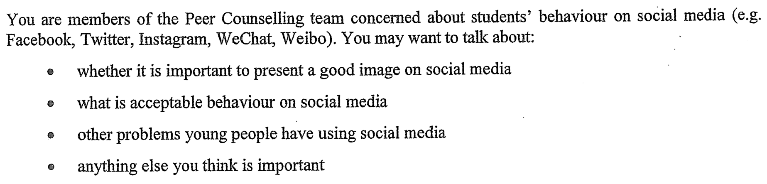
02 PART A – GROUP INTERACTION
Your discussion task
3

Slide 4
03 PART A – DISCUSS
Q1 Is a good image on social media important?
SUGGESTED IDEAS — noun phrases
a better first impression with employers
protection from shaming and scams
a stronger sense of self-respect
4

Slide 5
03 PART A – DISCUSS
Q2 What counts as acceptable behaviour?
SUGGESTED IDEAS — noun phrases
respect for other people’s privacy
checking before you share
thinking about the future
5

Slide 6
03 PART A – DISCUSS
Q3 What other problems do young people have online?
SUGGESTED IDEAS — noun phrases
cyberbullying and pile-ons
addiction and lost sleep
the pressure to compare
fake news and dangerous trends
6

Slide 7
04 SPEAK FOR 1 MINUTE
Part B – Question 7
Do you think the use of social media should be monitored?
SUGGESTED IDEAS — noun phrases
YES: protection from harmful content
YES: it reduces cyberbullying
NO: it damages trust
NO: it cannot keep up
7

Slide 8
04 SPEAK FOR 1 MINUTE
Part B – Question 8
Do you judge people based on what you see on social media?
SUGGESTED IDEAS — noun phrases
YES: the profile is often all we have
NO: the profile is a highlight reel
8

Slide 9
05 VOCABULARY UPGRADES
Say it like this — from the lesson
I post photos on a regular basis.
I am careful about my digital footprint.
I worry about being judged or shamed online.
A positive online presence now matters as much as a good school report.
Tagging a friend in an embarrassing photo probably crosses the line.
Anything you post can come back to haunt you.
Social media carries real risks if it is used without limits.
What people post is a curated highlight reel, not real life.
9

