Slide 1
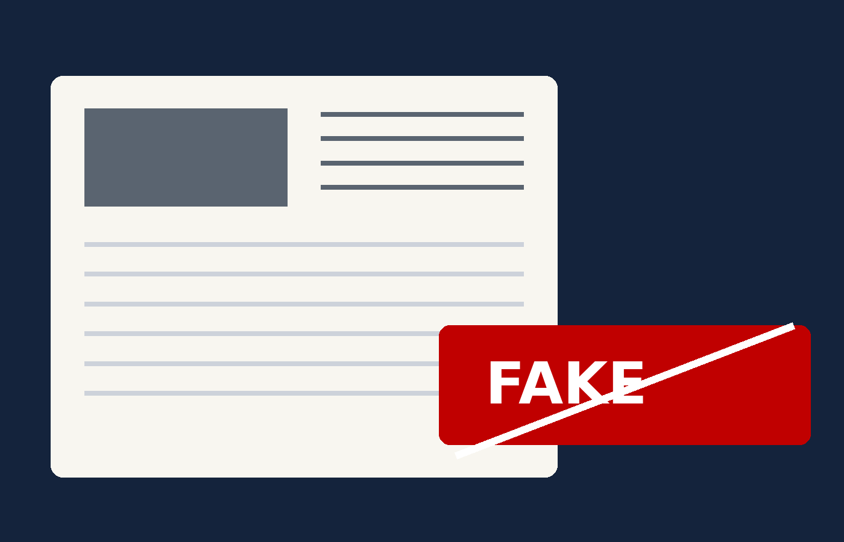
REAL OR FAKE?
DSE PAPER 4 · SPEAKING PRACTICE
Fake news
Misinformation online, press freedom
and censoring the internet
DSE 2018 Paper 4 Set 6.2 · Lesson 4
Check before you share

Slide 2

01 WARM-UP
Two questions to get you talking
QUESTION 1 (Student A)
QUESTION 2 (Student B)
What do you use the internet for?
Do you watch news on TV or on the internet?
2

Slide 3
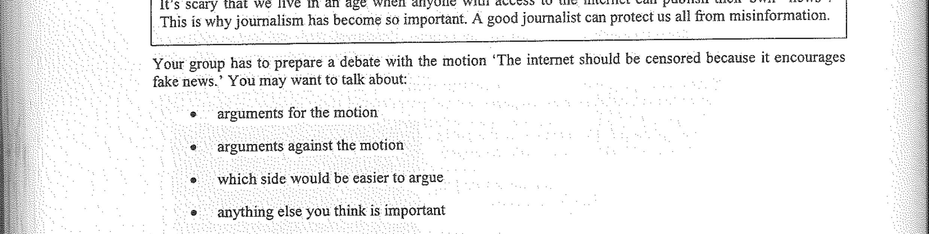
02 PART A – GROUP INTERACTION
Your discussion task
3

Slide 4
03 PART A – DISCUSS
Q1 Arguments for the motion
SUGGESTED IDEAS — noun phrases
protection from harmful misinformation
safer during emergencies
better quality information
4

Slide 5
03 PART A – DISCUSS
Q2 Arguments against the motion
SUGGESTED IDEAS — noun phrases
it threatens freedom of speech
“fake news” is hard to define
education works better than censorship
5

Slide 6
03 PART A – DISCUSS
Q3 Which side would be easier to argue?
SUGGESTED IDEAS — noun phrases
the motion is the easier case
the opposition is the easier case
we should argue what we believe
the evidence decides it
6

Slide 7
04 SPEAK FOR 1 MINUTE
Part B – Question 7
How can we raise people’s awareness about fake news?
SUGGESTED IDEAS — noun phrases
teach media literacy in school
label and flag false posts
run public campaigns with real examples
encourage checking before sharing
7

Slide 8
04 SPEAK FOR 1 MINUTE
Part B – Question 8
Should governments control what is on the internet?
SUGGESTED IDEAS — noun phrases
YES: the harm is real and growing
NO: control can be abused
8

Slide 9
05 VOCABULARY UPGRADES
Say it like this — from the lesson
We need to fact-check before we share.
Misinformation spreads faster than any correction can follow.
Putting the internet under the control of the authorities is easier said than done.
Once the authorities decide what is true, criticising them becomes the first casualty.
Teaching students to check a source protects them for life.
Media literacy should be built into the curriculum.
Unchecked misinformation is a genuine threat to public safety.
Freedom of expression has to be balanced against the harm of spreading lies.
9

