Slide 1

MUST-SEE TV?
DSE PAPER 4 · SPEAKING PRACTICE
The decline and fall of TVB
Free TV, streaming platforms
and Hong Kong popular culture
DSE 2018 Paper 4 Set 1.2 · Lesson 5
Still watching?

Slide 2

01 WARM-UP
Two questions to get you talking
QUESTION 1 (Student A)
QUESTION 2 (Student B)
Do you ever watch TVB?
Do you enjoy watching TVB dramas?
2

Slide 3
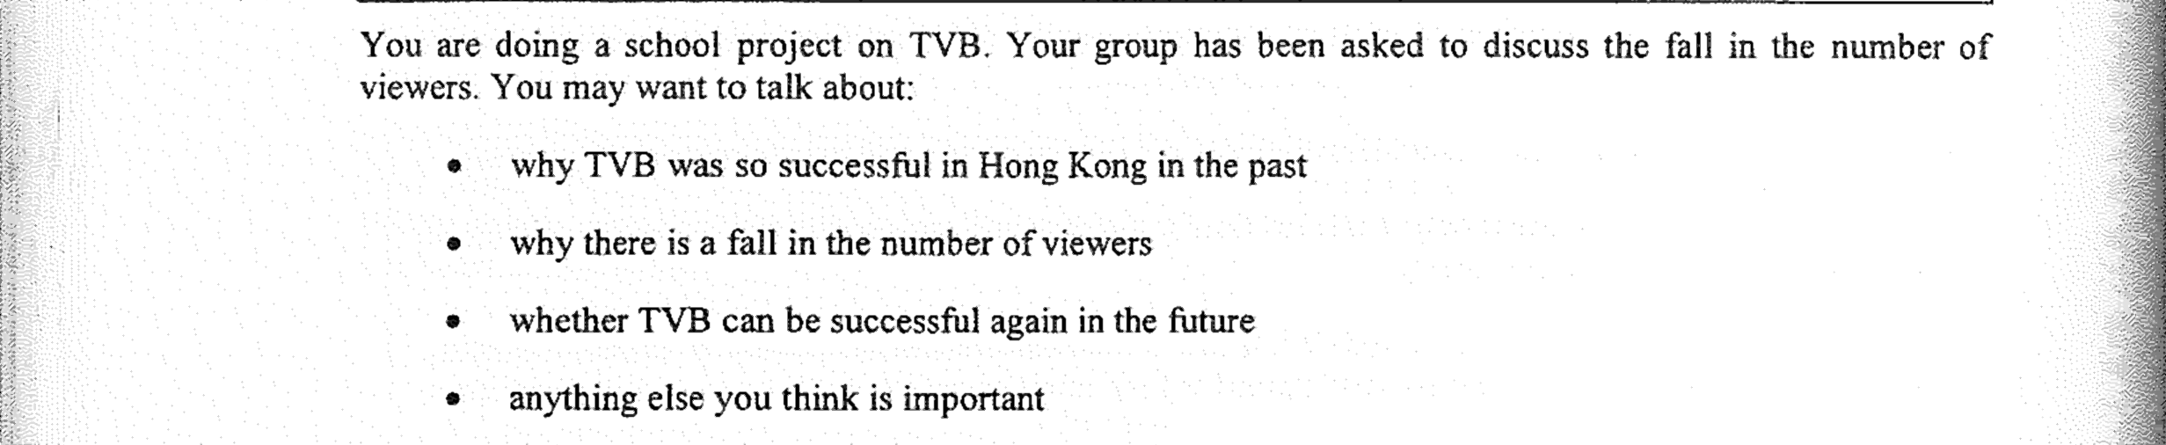
02 PART A – GROUP INTERACTION
Your discussion task
3

Slide 4
03 PART A – DISCUSS
Q1 Why TVB was so successful in the past
SUGGESTED IDEAS — noun phrases
it had almost no competition
a strong training academy
dramas that spoke to Hong Kong people
4

Slide 5
03 PART A – DISCUSS
Q2 Why there is a fall in the number of viewers
SUGGESTED IDEAS — noun phrases
audiences moved online
a lack of investment and creativity
too few faces on screen
5

Slide 6
03 PART A – DISCUSS
Q3 Can TVB be successful again?
SUGGESTED IDEAS — noun phrases
YES: one genuinely original series
YES: the streaming market is global
NO: the habit is broken
NO: the money cannot match the giants
6

Slide 7
04 SPEAK FOR 1 MINUTE
Part B – Question 7
How would you feel if TVB closed?
SUGGESTED IDEAS — noun phrases
NOT SORRY: the air time could go to fresher producers
NOT SORRY: my generation has already moved on
SORRY: Hong Kong would lose a shared living-room memory
SORRY: hundreds of people would lose their jobs
7

Slide 8
04 SPEAK FOR 1 MINUTE
Part B – Question 8
How important is TVB to Hong Kong culture?
SUGGESTED IDEAS — noun phrases
IMPORTANT: it created a shared culture
NOT IMPORTANT: it no longer sets the tone
8

Slide 9
05 VOCABULARY UPGRADES
Say it like this — from the lesson
TVB’s audience has fallen sharply over the last decade.
Many of the dramas rely on the same props and plots.
Younger viewers have moved to streaming platforms.
For twenty years TVB dominated free-to-air television.
Only original drama could reverse the decline.
Its cultural influence has faded as audiences have fragmented.
It has lost the creative edge it once had.
TVB was central to the way Hong Kong people saw themselves.
9

