Slide 1

HK$4 A DAY
DSE PAPER 4 · SPEAKING PRACTICE
Doing charity work
Helping overseas, the cost of the trip
and whether it should be compulsory
DSE 2016 Paper 4 Set 1.1 · Lesson 6
Does the trip make a difference?

Slide 2

01 WARM-UP
Two questions to get you talking
QUESTION 1 (Student A)
QUESTION 2 (Student B)
Have you done any charity work?
Would you prefer to do charity work locally or outside Hong Kong?
2

Slide 3
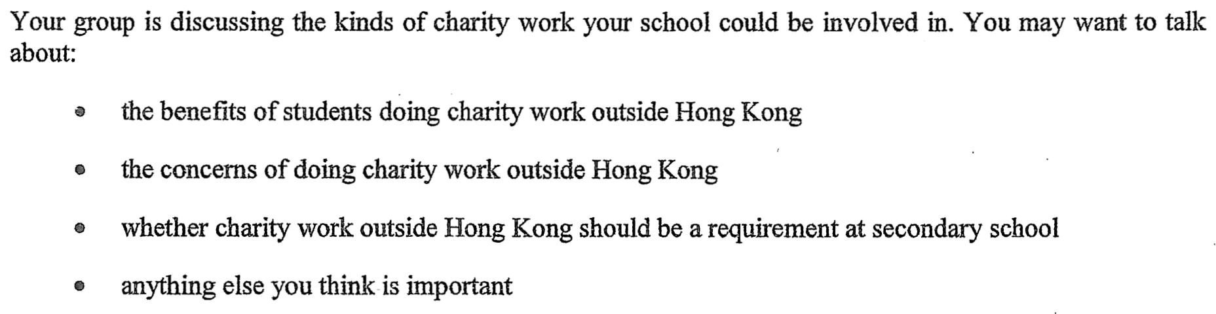
02 PART A – GROUP INTERACTION
Your discussion task
3

Slide 4
03 PART A – DISCUSS
Q1 The benefits of charity work outside Hong Kong
SUGGESTED IDEAS — noun phrases
a wider worldview
empathy and a sense of responsibility
practical skills and confidence
4

Slide 5
03 PART A – DISCUSS
Q2 The concerns of charity work outside Hong Kong
SUGGESTED IDEAS — noun phrases
the cost excludes poorer students
short trips may achieve little
safety and supervision
5

Slide 6
03 PART A – DISCUSS
Q3 Should charity work outside Hong Kong be a requirement?
SUGGESTED IDEAS — noun phrases
YES: everyone would experience it
YES: it builds character
NO: it puts families under pressure
NO: forced service is not service
6

Slide 7
04 SPEAK FOR 1 MINUTE
Part B – Question 7
Do you think charity work can make a difference?
SUGGESTED IDEAS — noun phrases
YES: small, practical help is real
YES: the volunteers change too
NO: it may not last
NO: money often works better
7

Slide 8
04 SPEAK FOR 1 MINUTE
Part B – Question 8
Who benefits more from charity work outside Hong Kong: the volunteers or the locals?
SUGGESTED IDEAS — noun phrases
VOLUNTEERS: the experience is life-changing for us
LOCALS: the practical support is what matters
8

Slide 9
05 VOCABULARY UPGRADES
Say it like this — from the lesson
I took part in a charity drive at school.
Charity work builds empathy and a sense of responsibility.
The trip costs each student around HK$5,000, which many families cannot afford.
It makes a difference to the individuals we work with.
Donations often achieve more per dollar than a week-long trip.
Short visits raise a real question about their long-term impact.
The volunteers change as much as the communities they visit.
For the community the benefit is measurable: extra teachers and finished buildings.
9

