Slide 1

HK CAFÉ IN SHANGHAI
DSE PAPER 4 · SPEAKING PRACTICE
A Hong Kong coffee shop in Shanghai
Menu, Hong Kong culture
and how to decorate the space
DSE 2016 Paper 4 Set 6.3 · Lesson 7
What goes on the menu?

Slide 2

01 WARM-UP
Two questions to get you talking
QUESTION 1 (Student A)
QUESTION 2 (Student B)
Do you go to coffee shops?
Would you like to go to a teddy bear coffee shop?
2

Slide 3
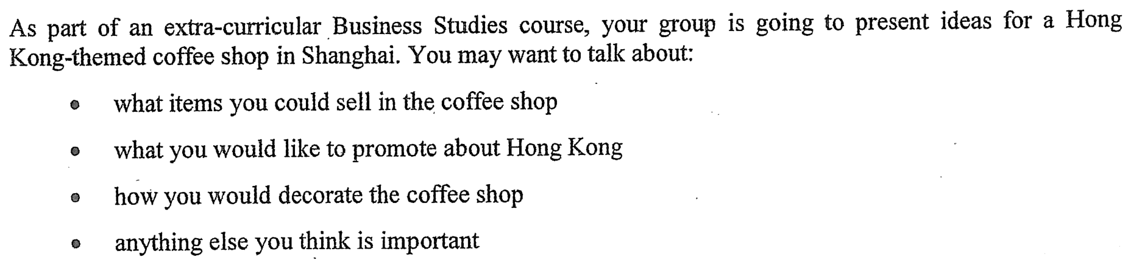
02 PART A – GROUP INTERACTION
Your discussion task
3

Slide 4
03 PART A – DISCUSS
Q1 What items could you sell in the coffee shop?
SUGGESTED IDEAS — noun phrases
Hong Kong-style drinks
classic local snacks
branded merchandise
4

Slide 5
03 PART A – DISCUSS
Q2 What you would like to promote about Hong Kong
SUGGESTED IDEAS — noun phrases
the food culture
the look of the city
Cantonese language and culture
5

Slide 6
03 PART A – DISCUSS
Q3 How would you decorate the coffee shop?
SUGGESTED IDEAS — noun phrases
a retro Hong Kong interior
neon signage and a photo corner
a Cantopop soundtrack
a Hong Kong art wall
6

Slide 7
04 SPEAK FOR 1 MINUTE
Part B – Question 7
What theme would be popular in a coffee shop in Hong Kong?
SUGGESTED IDEAS — noun phrases
a retro Hong Kong theme
a film or cartoon character theme
an arts and music theme
a pet-friendly theme
7

Slide 8
04 SPEAK FOR 1 MINUTE
Part B – Question 8
How important is the atmosphere of a coffee shop?
SUGGESTED IDEAS — noun phrases
IMPORTANT: people pay for the experience
NOT IMPORTANT: the drink must still be good
8

Slide 9
05 VOCABULARY UPGRADES
Say it like this — from the lesson
The atmosphere is what draws me in.
Customers come for the whole café experience, not just the coffee.
I would serve a short menu of Hong Kong classics — egg tarts and pineapple buns.
The décor could promote Hong Kong’s cultural heritage.
A strong visual theme gives customers a reason to come and to post.
An Instagram corner is free advertising — every guest becomes our marketer.
The atmosphere is what allows the café to charge premium prices.
The experience brings customers in, but the coffee brings them back.
9

